Slide 1
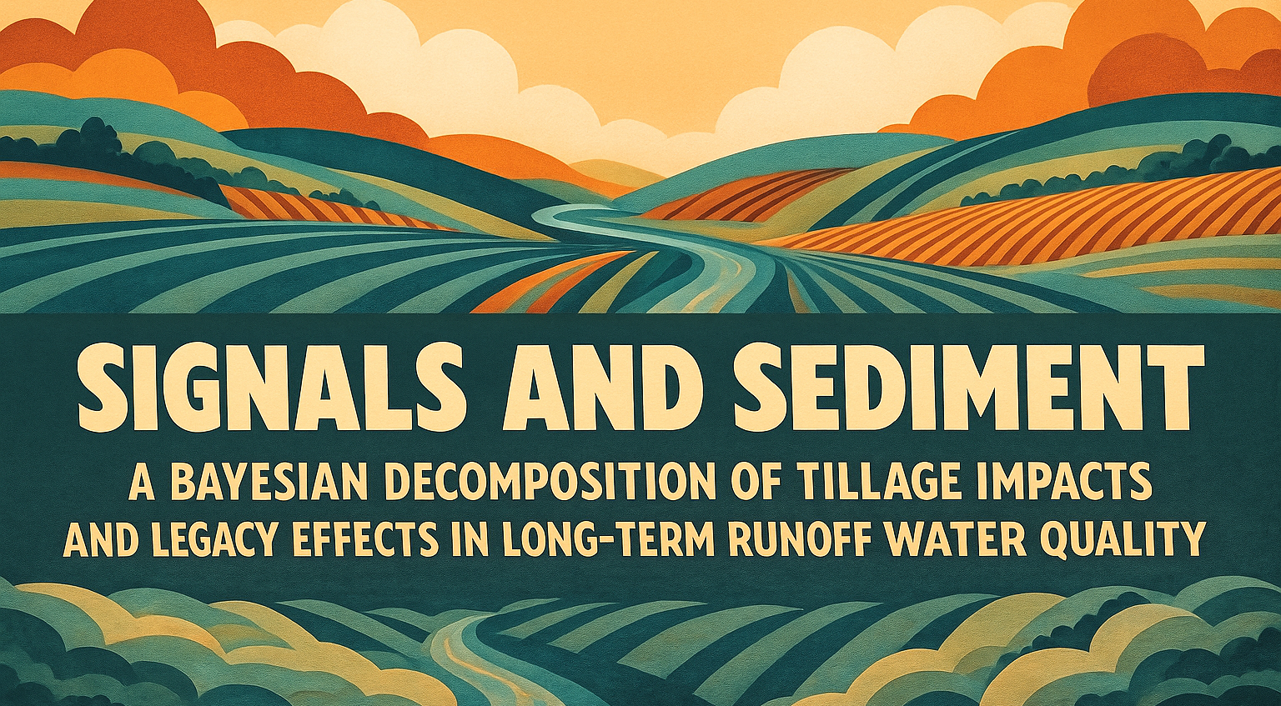
A.J. Brown
15 Dec 2025

Slide 2
Background
Conservation tillage study initiated in 2010
Planned with key farming stakeholders to ensure applicability to real-world scenarios
Data have been collected over the 2011 – 2025 period using multiple methods for water quality and quantity
Overarching goal of investigating the impacts of tillage on runoff water quality, soil health, and agronomic/economic productivity
As of Oct 2025, all water quality, tillage, and crop data have been compiled and merged for research use

Slide 3
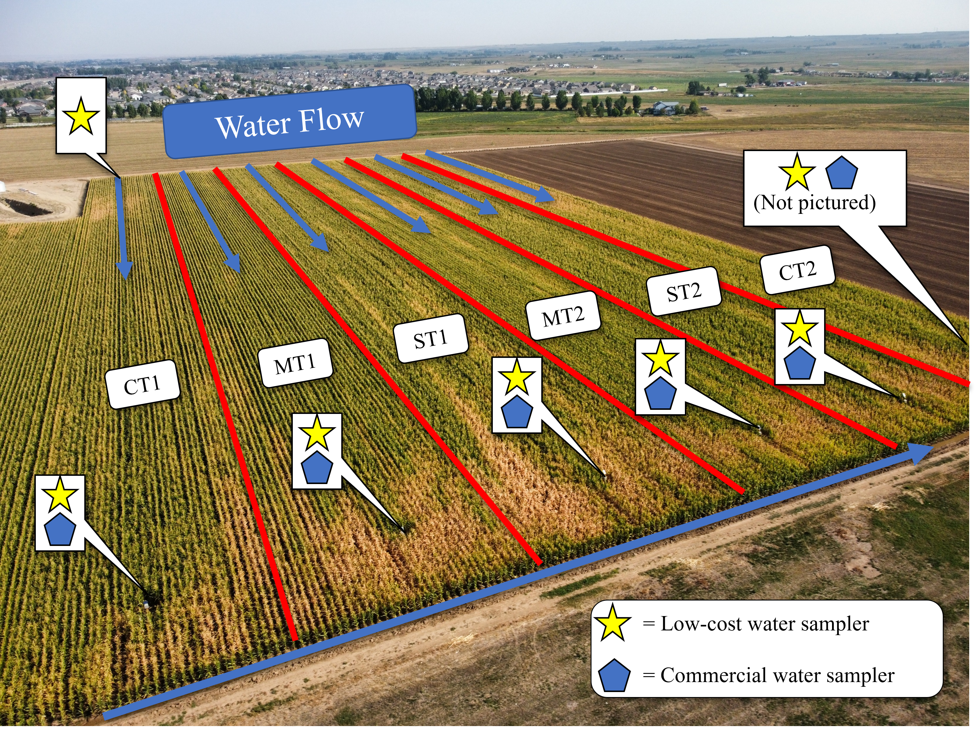
Livin’ on a Layer (of Residue)
Study site in Fort Collins, CO, USA
2011-2025
Conservation Tillage Study started in 2011
CT = Full tillage
MT = Less tillage
ST = Least tillage
Replicated treatment blocks (1 & 2)
Each plot is about 1 hectare with a 300m irrigation run length
Surface irrigated with siphon tube or gated pipe for 7-10 hours at a time

Slide 4
Diving deeper: Investigating tillage impacts on water quality
Trimarco et al., 2025 found:
Reduced tillage cut particulate pollutant concentrations.
Better soil structure and organic matter aligned with cleaner runoff.
Strip and minimum till performed similarly and both outperformed conventional tillage.
What remains?
Investigation into volume and loadings between treatments over time
Quantifying the actual causal impact of tillage on various analyte concentration and load
Investigating persistence effects of tillage on analytes, if any (unique aspect of these long-term data)

Slide 5
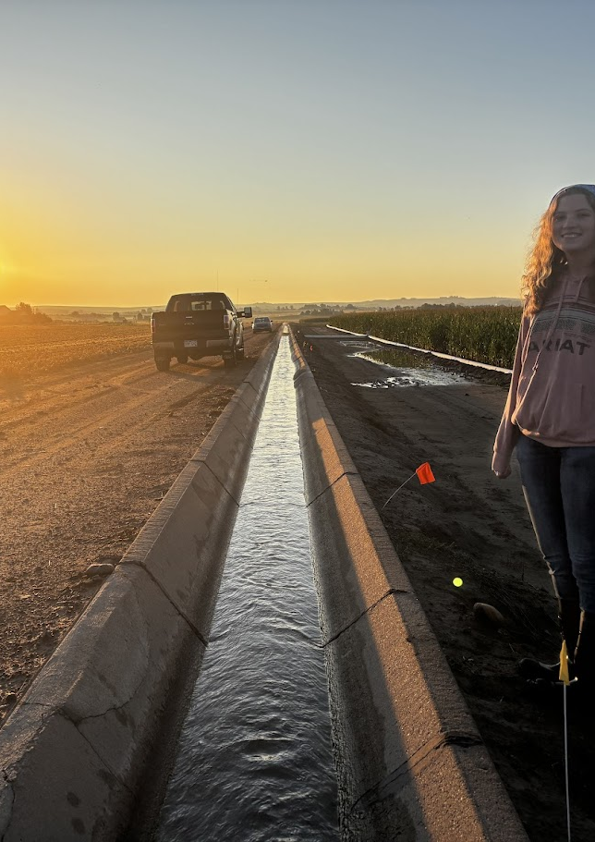
Proposed Research Objectives*
Characterize treatment differences in water-quality loads through time
Use the long-term edge-of-field dataset to estimate how sediment and nutrient loads differed among conventional, strip, and minimum tillage, accounting for year-to-year variability and uncertainty in flow and concentration.
Estimate the causal effect of tillage on individual analytes
Apply hierarchical Bayesian models to isolate the effect of tillage on concentrations and loads for each analyte, separating true treatment signals from measurement error, missing data, and shared temporal structure across analytes.
Identify whether tillage influences persist across years
Leverage the multi-year record and the multi-output Gaussian process to determine whether tillage effects are short-lived or temporally persistent, evaluating the degree to which past disturbance continues to shape present-year water-quality outcomes.
*These objectives reflect ongoing analyses conducted as part of my Ph. D. research and will contribute directly to my dissertation.

Slide 6
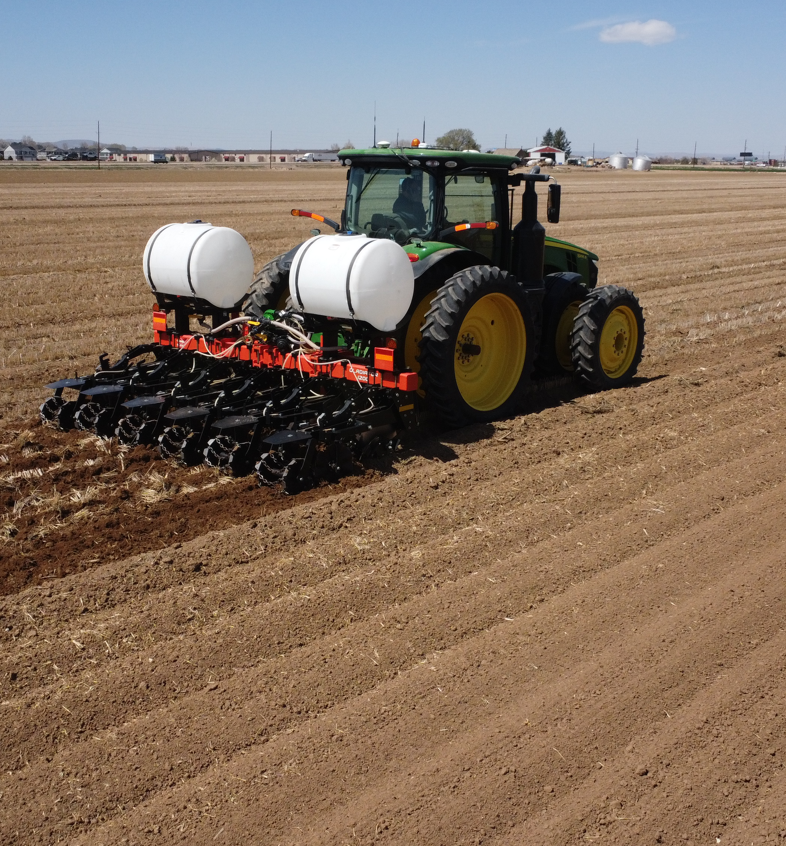
Problem: Tillage varies in reality
Tillage treatments had fairly standard procedures
MT = Vertical Tillage + liquid N + banded P
ST = Strip Tillage + liquid N + banded P
CT = Moldboard Plow + broadcast N and P
However, some years merit change due to practical considerations
E.g., VT whole field to prep for wheat planting the day following corn harvest in 2023

Slide 7
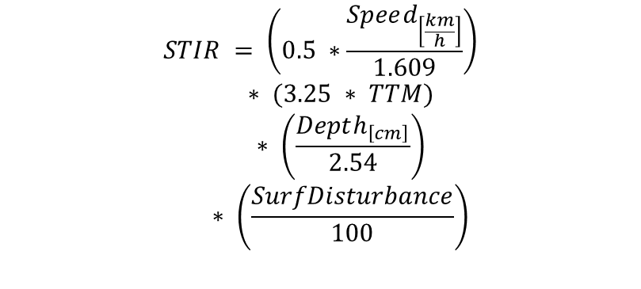
STIR Me Up Before You Go-Go
Soil Tillage Intensity Rating (STIR)
Continuous value that quantifies the overall physical disturbance to the soil caused by a tillage operation
STIR is used in multiple mechanistic models for soil physical impacts (e.g., RUSLE2)
For Kerbel: allows us to account for varying tillage in years where CT/MT/ST treatments were not consistent
Term | Description | Conversion | Notes
Speed [km/h] | Average implement speed | ÷ 1.609 → mph | Converts from km/h to miles per hour
TTM | Tillage Type Modifier [0–1] | none | Represents the aggressiveness of the implement (0 = no till, 1 = full inversion)
Depth [cm] | Average operating depth | ÷ 2.54 → inches | Converts from centimeters to inches
Surf_Disturbance [%] | Percent of soil surface disturbed | ÷ 100 → fraction | Captures the area of soil affected by the implement
STIR | Soil Tillage Intensity Rating | — | Dimensionless intensity index
$$∗ \left(\frac{SurfDisturbance}{100}\right) ∗ \left(\frac{Depth_{\left[cm\right]}}{2.54}\right) ∗ (3.25 ∗ TTM)STIR = \left(0.5 ∗\frac{Speed_{\left[\frac{km}{h}\right]}}{1.609}\right)$$

Slide 8
Novelty
STIR has never been used as a continuous predictor in a statistical model of observed edge-of-field water-quality concentrations or loads.
Process-based models simulate disturbance directly through mechanistic parameters, so no model links STIR numerically to pollutant export.

Slide 9
What others do with STIR and why it exists
Used in RUSLE2 and related NRCS tools to represent soil-disturbance intensity that drives predicted erosion and associated sediment-bound nutrient loss (USDA NRCS, 2012; Winger, 2023).
Applied as a management index to classify tillage systems for expected runoff and sediment-loss reductions, not to predict observed water-quality measurements (Ferruzzi, 2023; USDA NRCS, 2022).
Treated as a proxy for residue disturbance and aggregate disruption that influences runoff generation, but rarely modeled against field-measured concentrations or loads (Karlen et al., 2008; Sittig and Sur, 2024).
NRCS uses STIR primarily for:
Tillage classification
Conservation compliance thresholds
Erosion predictions in RUSLE2
Qualitative links to water-quality benefit
Ferruzzi, G. (2023). Farming Implements in Action: Impacts of Tillage on Soil Disturbance. USDA-NRCS Western Technical Center.
Karlen, D. L., et al. (2008). Soil quality and the RUSLE2 framework for evaluating soil disturbance. Journal of Soil and Water Conservation.
Sittig, N., and Sur, M. (2024). Conservation tillage effects on runoff and erosion: A meta-analysis. Agricultural Water Management.
USDA NRCS (2012). National Agronomy Manual: Residue and Tillage Management Standards 329 and 345.
USDA NRCS (2022). RUSLE2 Operations Database and Soil Tillage Intensity Rating (STIR) Documentation.
Winger, M. (2023). Soil Tillage Intensity Rating training materials. USDA-NRCS.

Slide 10
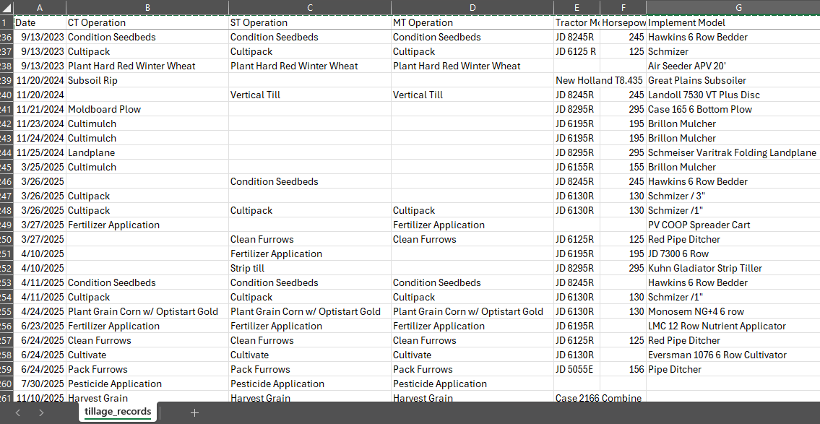
STIR Results for Kerbel 2011 - 2025
Snapshot of tillage database
Starting with Tad’s compilation of tillage records as prepared for DayCent (a less robust version of the STIR), I matched these activities (and added 2024 and 2025) to STIR values with assumed tractor speeds from the MOSES (Management Operations and Soil Erosion Simulation) database from NRCS

Slide 11
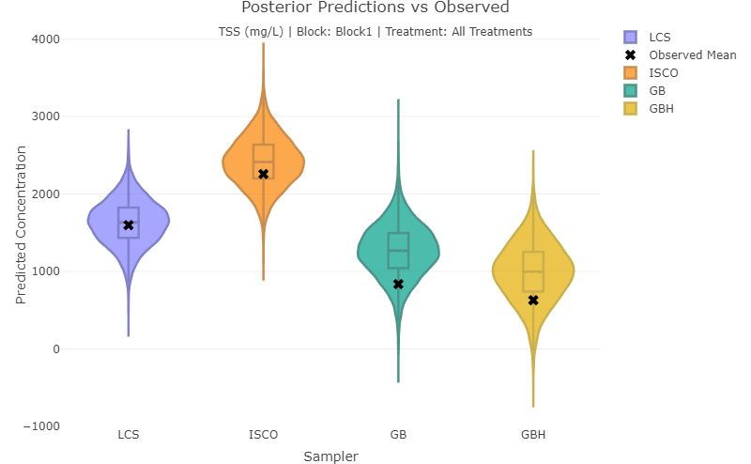
Problem: Measurement is Hard
Over the years, various methods have been used to collect water quality and quantity
For example:
Stage measurement: Pressure Transducer, Ruler, Bubbler, and Etape
Flume type: Weir, 7” V-notch, 8” V-notch, 10” V-notch, and 60° V-Trapezoidal Flume (current)
Sampler method: GBW, ISCO, GB, LCS, GB3, and GBH
Analytes have also changed over years
These various methods have varying certainties, which need to be accounted for to harmonize a long-term dataset like this.
Additionally, there are tons of missing data for various reasons related to resource availability for any given year.
TSS comparison example: Our recent, Brown et al., 2025 paper is a great example of trying to account for this in sampler method

Slide 12

The Times They Are A-Changin’, So Let’s Use a Bayesian Causal Model
Causal models help define a statistical model with scientific assumptions
Statistical models calibrated with Bayesian methods (e.g., Hamiltonian Monte Carlo) provide several advantages
Imputation of missing data
Handles small, irregular, and unbalanced data well with informed priors
Propagates measurement error explicitly
Models variables jointly, capturing shared correlations for extra ‘horsepower’
And more!
Thomas Bayes (1761), Presbyterian minister (and statistician) of the Mount Sion chapel in Kent, UK

Slide 13
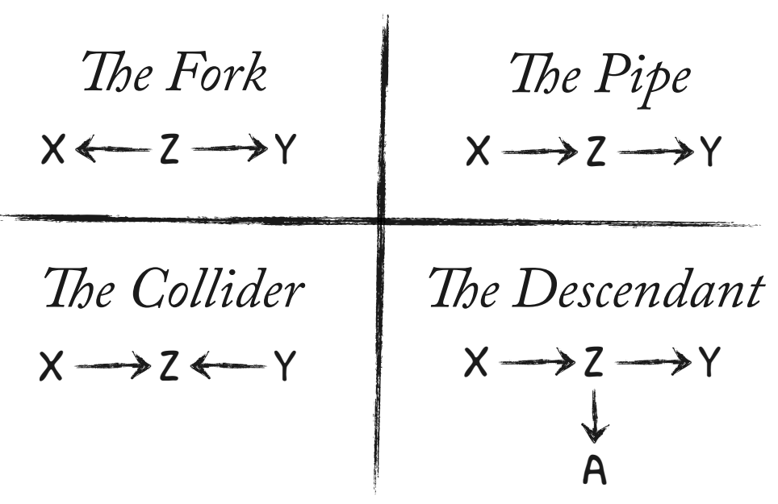
Under Pressure… From Confounders
Confounders from (McElreath, 2023)
Directed Acyclical Graphs (DAGs) define rules for developing statistical models by following the rules of “do-calculus” i.e., P(y | do(x))
This is where the scientist’s expertise comes in
So, I made one of these for our Kerbel water dataset…
AJ Agronomy Example
Red
NIR
NDVI
Regress by NDVI OR Red & NIR NOT both
Plant Health

Slide 14
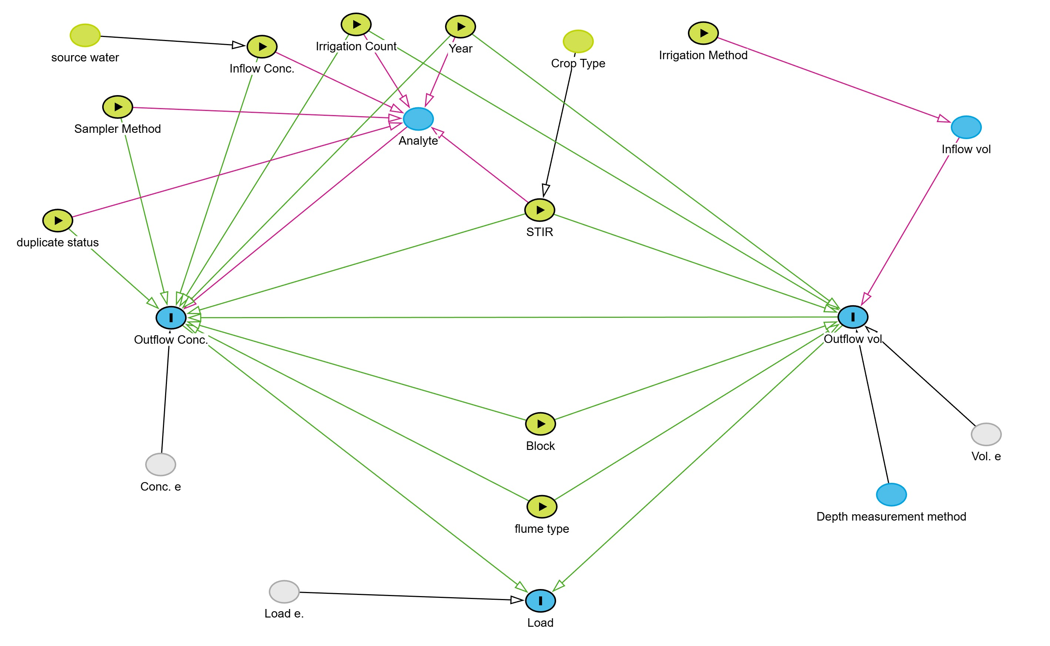

Slide 15




Model You Like a Hurricane
“Full Luxury Bayes”
2 simultaneous models are needed to quantify the direct impact of STIR on load:
STIR → Volume
STIR → Concentration
What needs to be included in these regression models?
STIR Only
STIR, Analyte, Block, Inflow Conc., Irrigation Count, Outflow vol, Sampler Method, Year, duplicate status, flume type
In Bayes, we can run two models simultaneously to let them learn from each other, and it’s often needed in cases like these, termed, “Full Luxury Bayes”

Slide 16
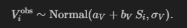
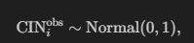
Model 1: STIR → Runoff Volume (9845 missing data, i.e., NAs)
Model 2: STIR → Concentration (5599 NAs)
$f_{a, Y_{i}}$is a special parameter called a multi-output Gaussian Process (MOGP).
The MOGP is some fancy matrix algebra that:
Learns a year-to-year trend that all analytes share to some degree (i.e., the “Kernel function”).
Allows each analyte to respond differently to that trend, so they can move together or independently.
Borrows “strength” across analytes and years, improving estimates when data are sparse, missing, or noisy.
Provides realistic uncertainty by modeling temporal variation directly rather than treating it as random noise.
Bonus model: Inflow NA values (9999 NAs)
In Bayes, we can (and should) model missing data as another parameter, resulting in many many parameters like we saw here

Slide 17
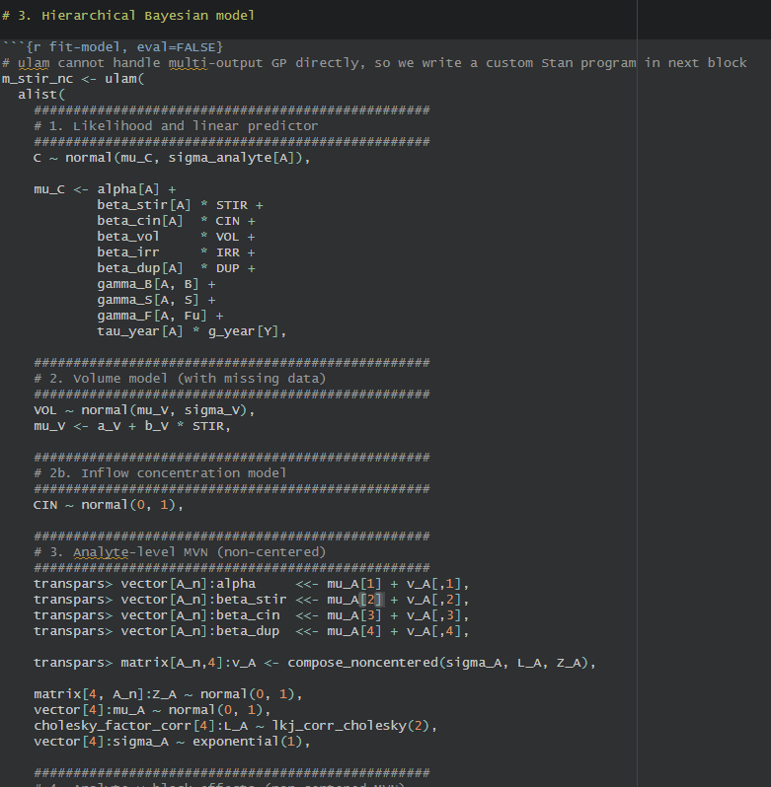


“Stan” by Me
Run model in R
50 minutes, 0.7 GBs of result
27, 415 parameters fit on 15,366 data points??
Normal in Bayes ☺
Model “converges” well!
Stan Software
Rethinking package

Slide 18
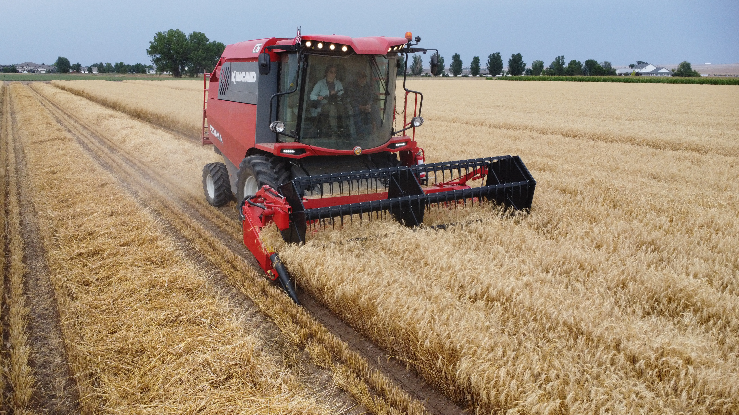
Hit Me With Your Best Plot (Results so far)

Slide 19
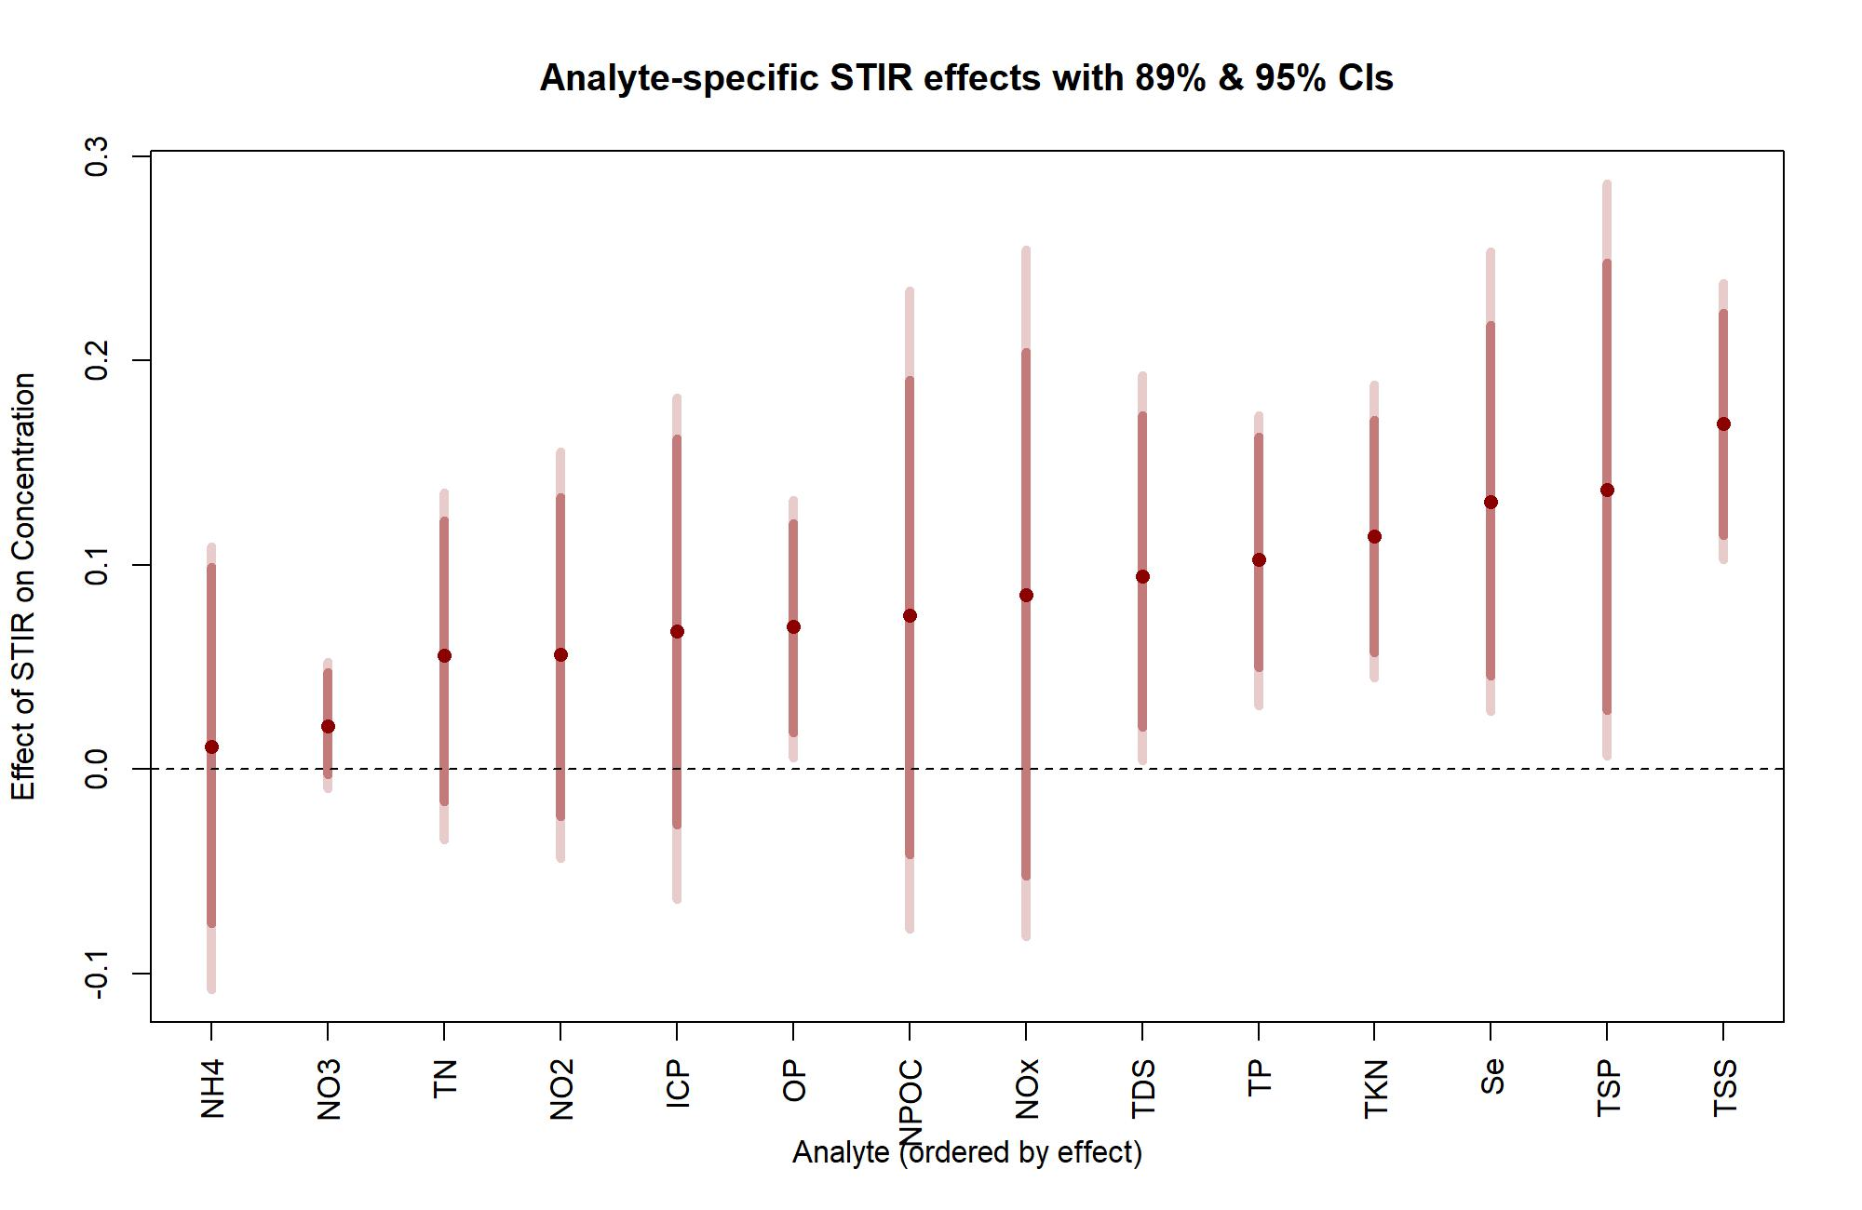
Signed, Sealed, Delivered (It’s STIR)
STIR effects ranked from least to most by analyte type
TDS, TP, TKN, Se, TSP, OP, and TSS were significantly affected
Wider CIs are indicative of fewer data
Results seem to follow theory that insoluble particulates are impacted most, minus OP

Slide 20
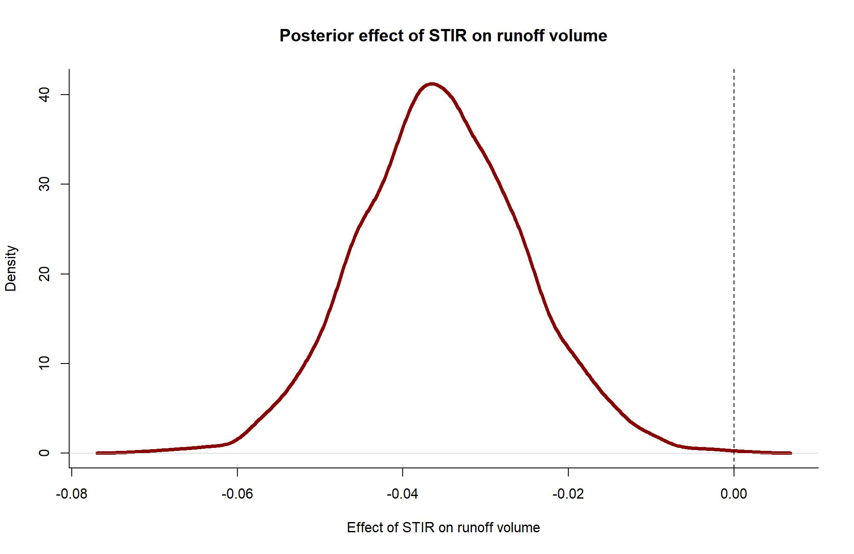
Pump Up the Volume
STIR had a negative impact on volume
This seems contrary to observations and theory. Need to look into this.
Impact is small in magnitude; could be biased by recent MT/ST data

Slide 21
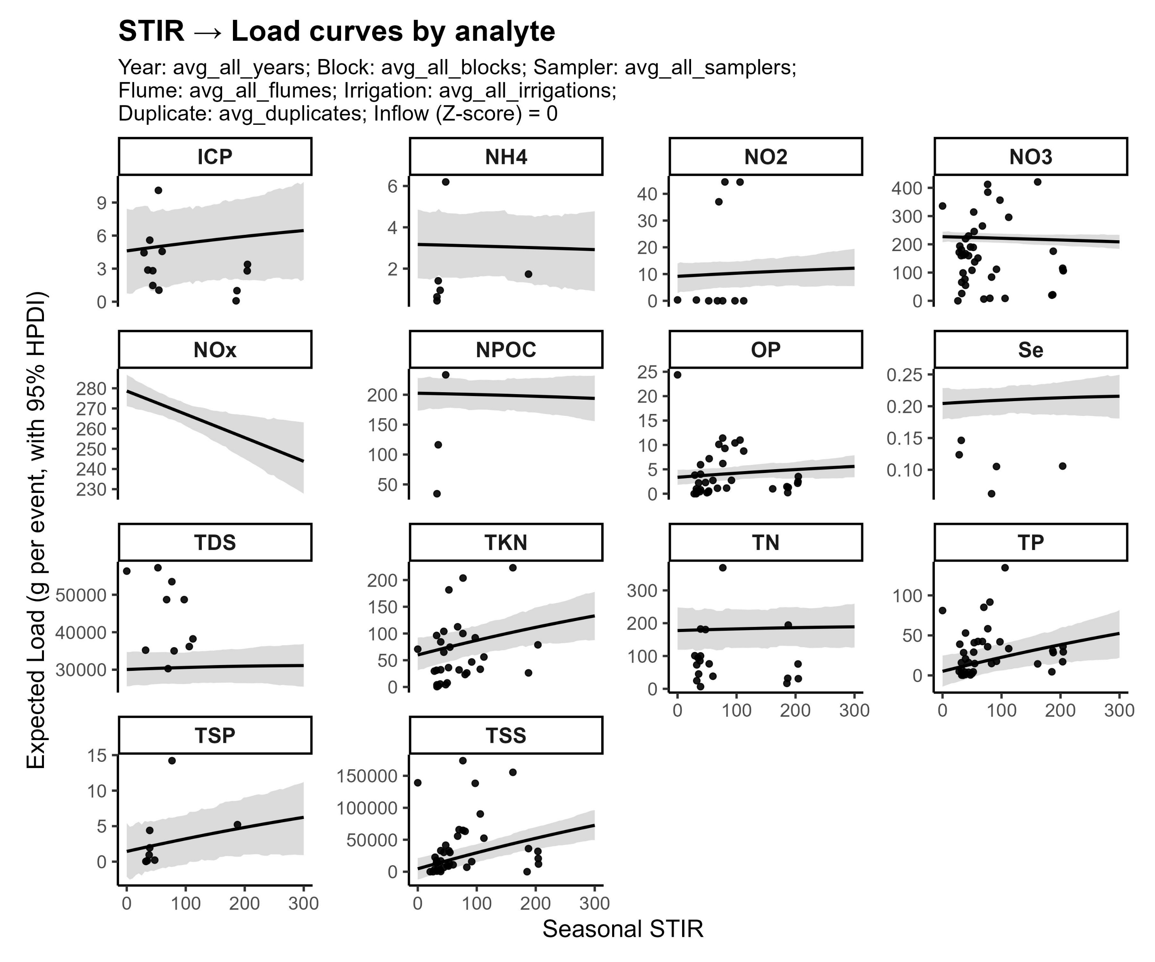
Load on the Water
Here are the results we want; STIR impacts on LOADS
Fit looks poor b/c it’s averaging over a lot of stuff
Checks out with theory
TP, TSS, TSP, TKN most affected

Slide 22
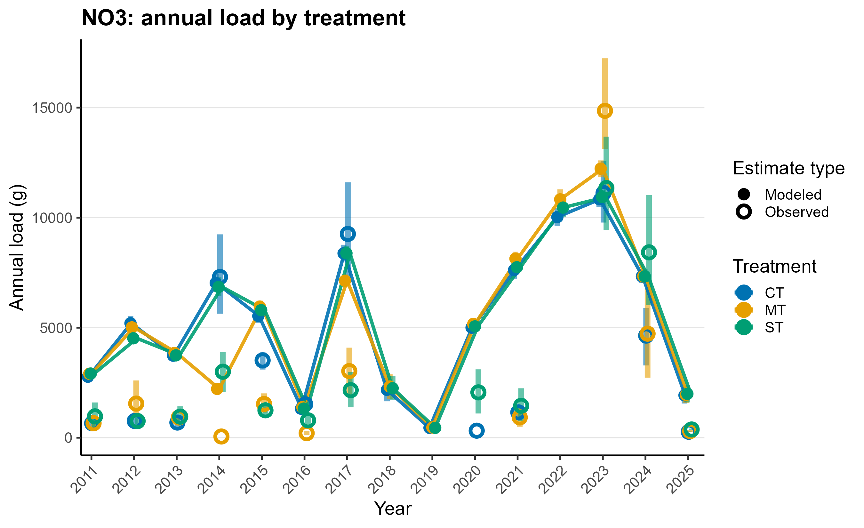
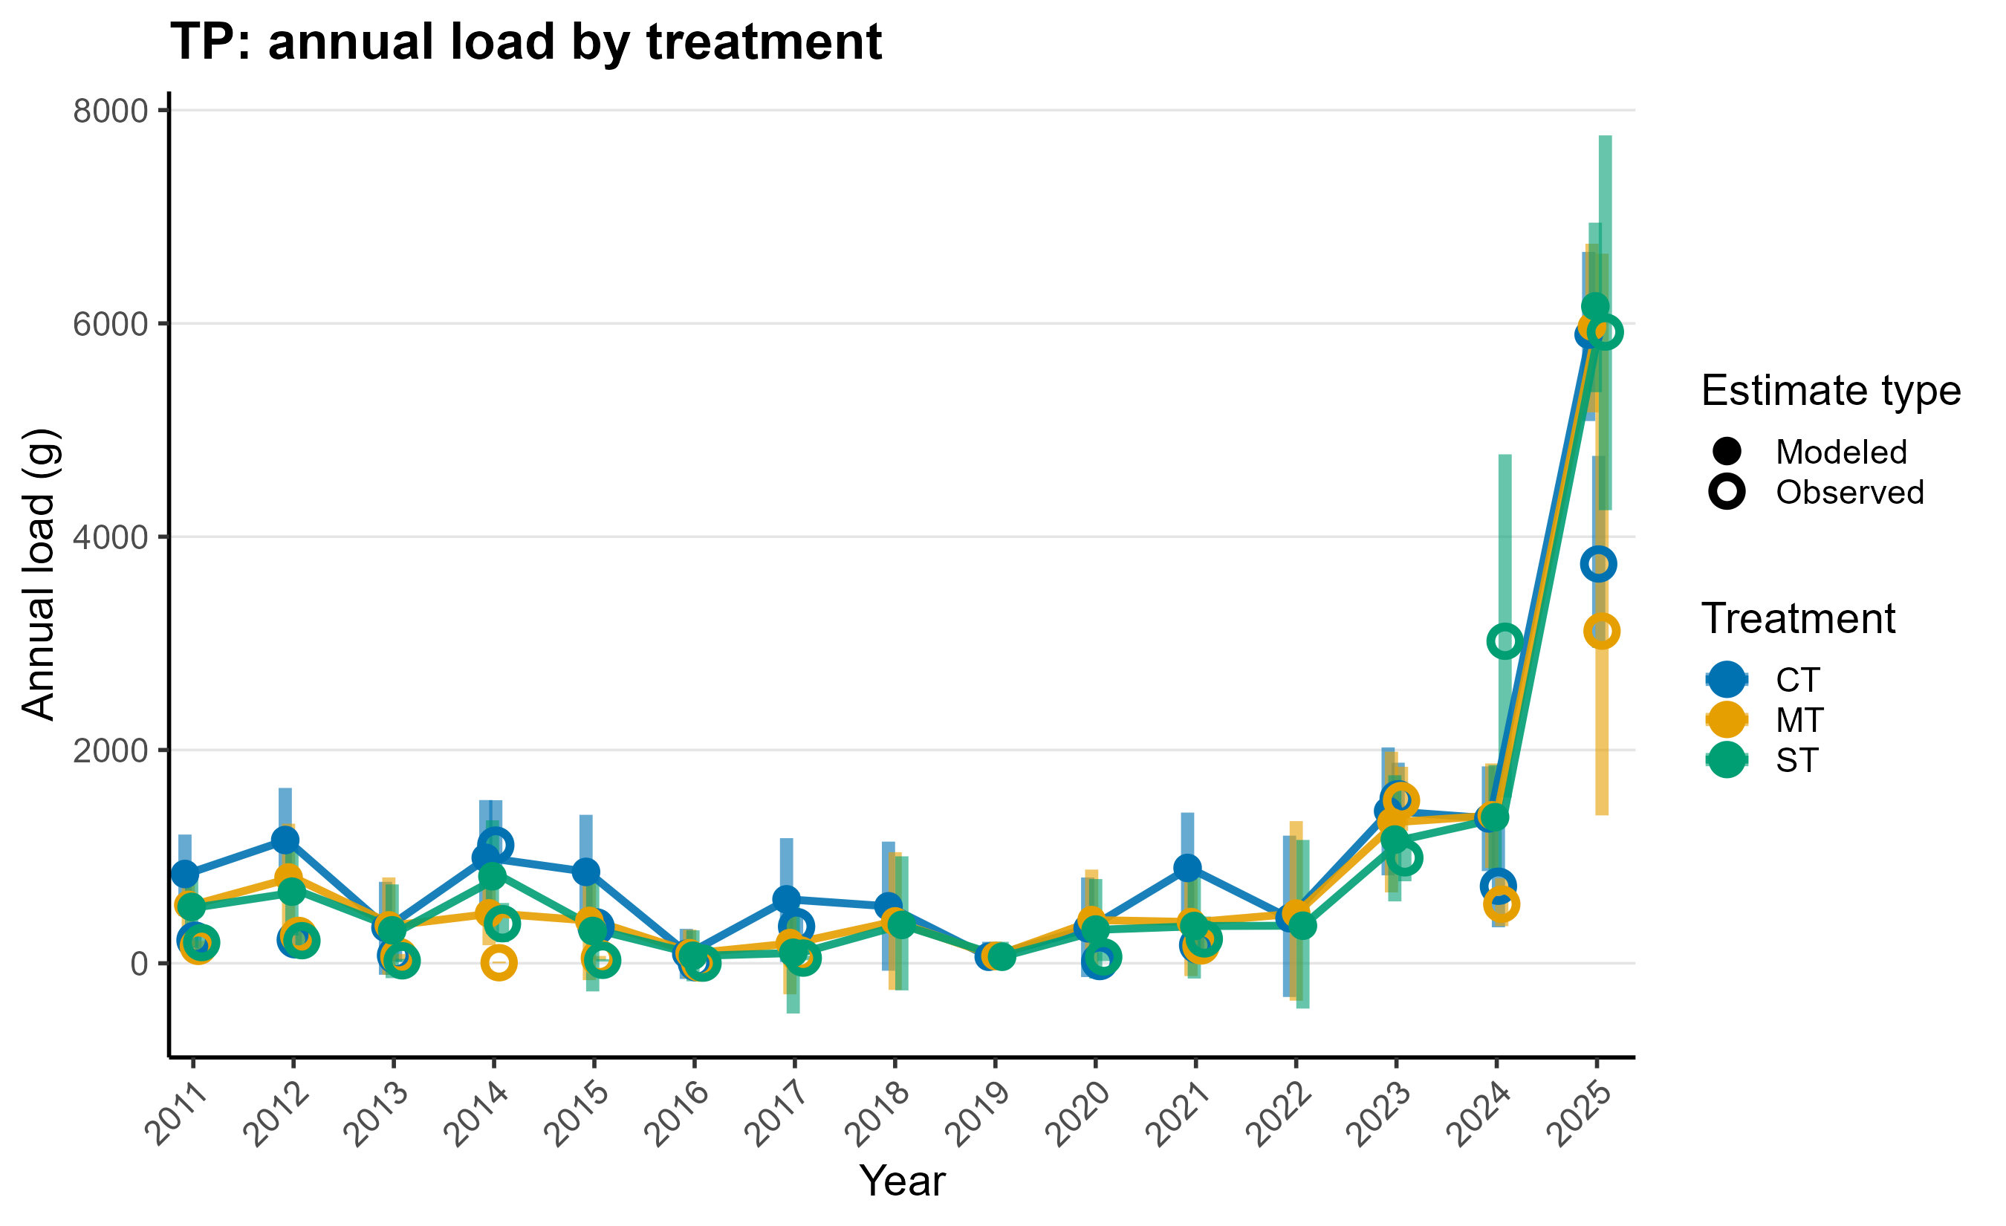
Bridge Over Troubled Data
NO3? Not so good
TP? Very good
Even though the model doesn’t utilize treatment (CT/ST/MT), I thought it would be useful to calculate loads on a trt-level
Graph shows modeled and observed data with 95% CIs
This was done for all analytes
Model does well on variables that have stronger STIR relationships!

Slide 23
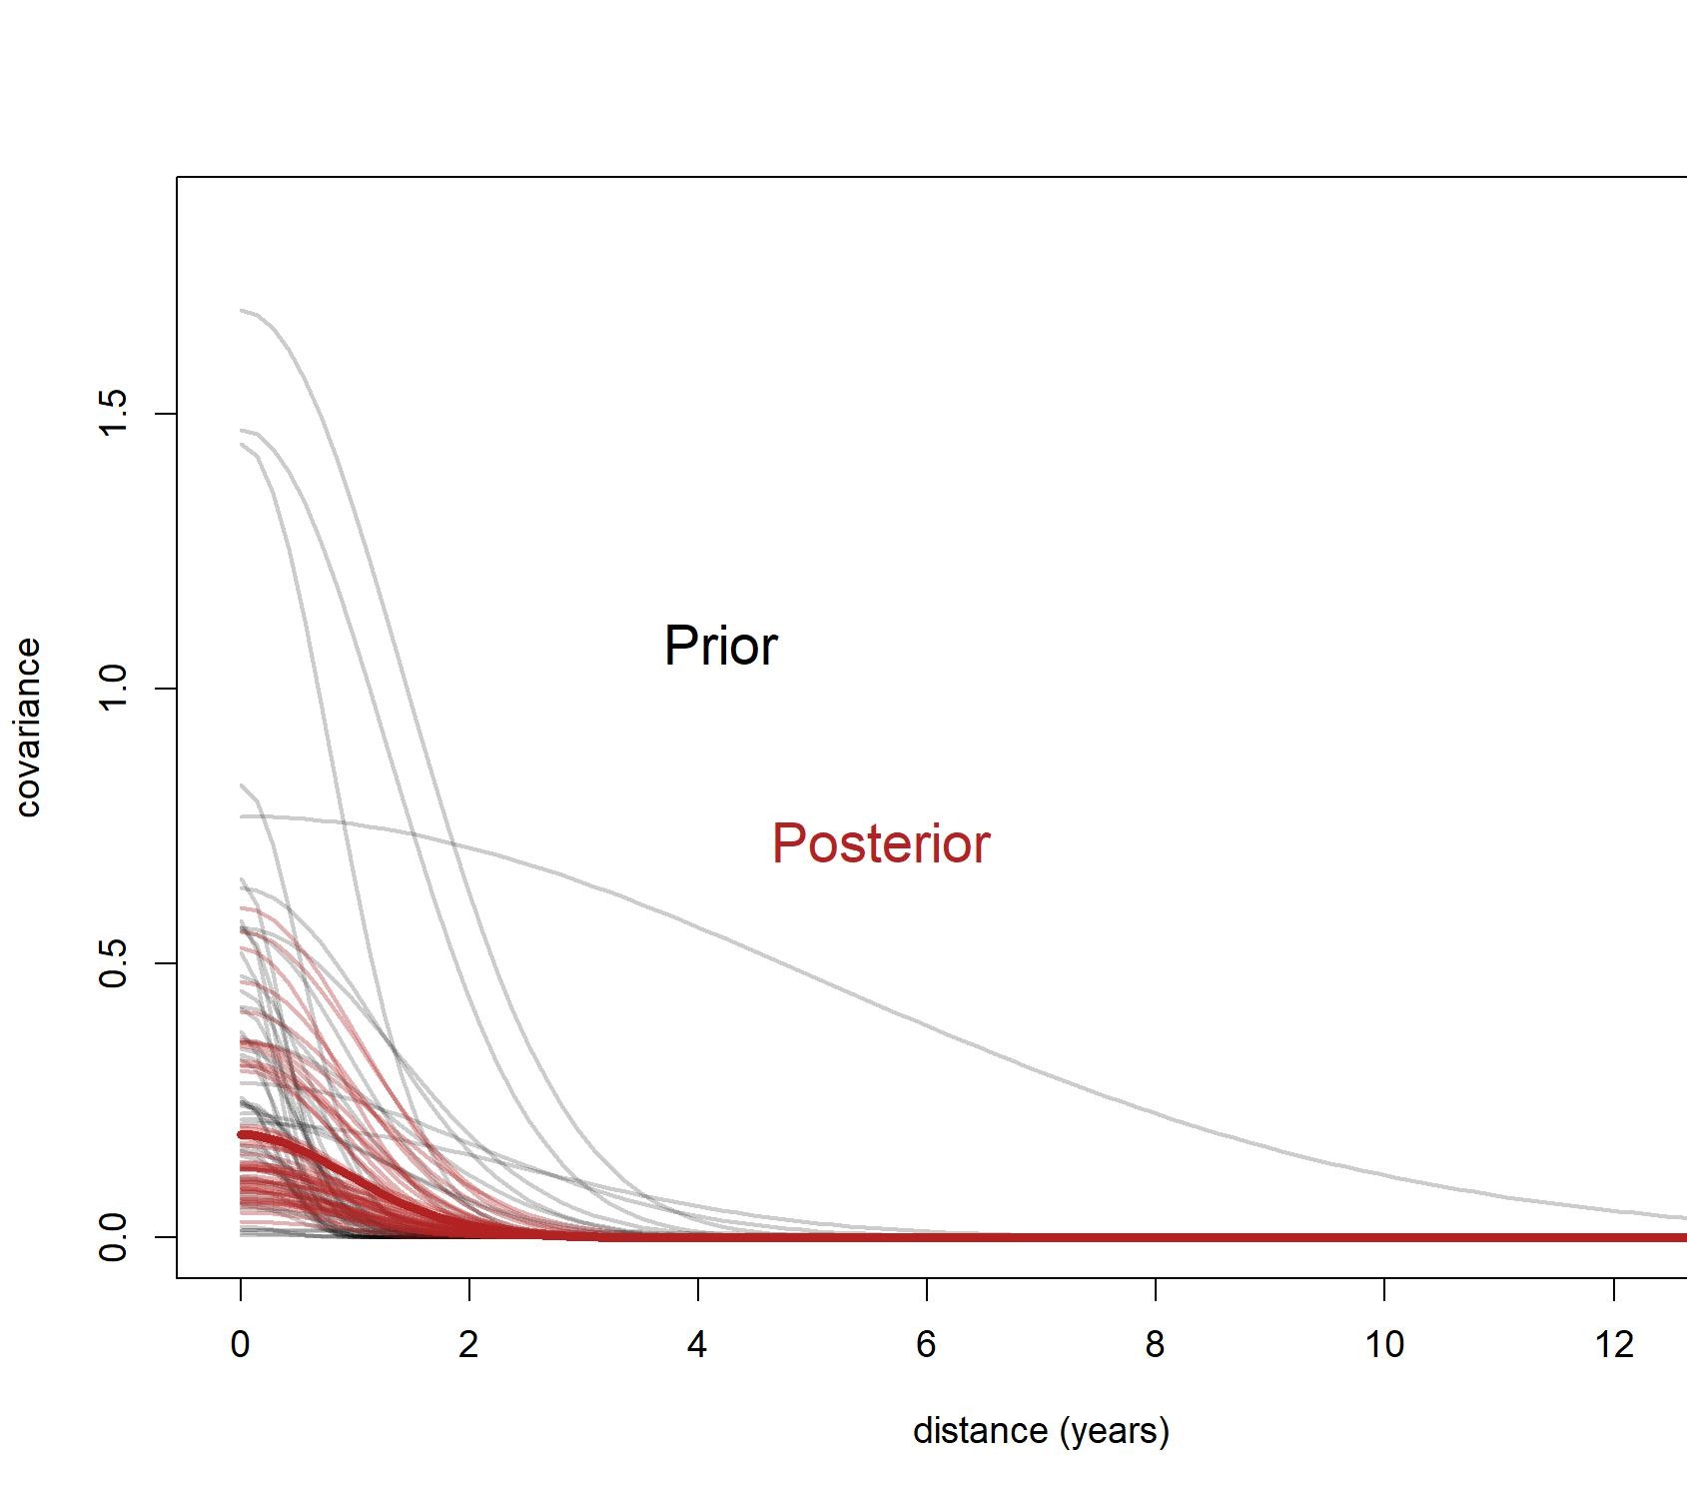
Don’t Stop Decaying
This is the temporal kernel function from the MOGP
Data did change the prior (good)
Posterior shows that there is very little covariance after a single year over all analytes

Slide 24
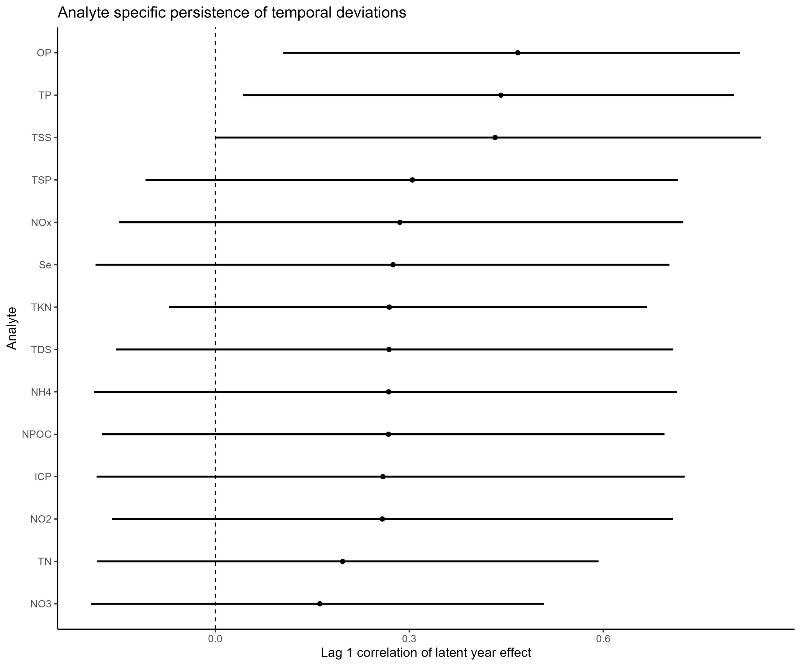
Time After Time (But Only for Some Analytes)
AR(1) regression effect from MOGP
So which analytes had temporal effects?
OP, TP, TSS <- clearly
TSP, TKN <- sort of
This graph represent she ability of a previous year to predict this year’s load

Slide 25
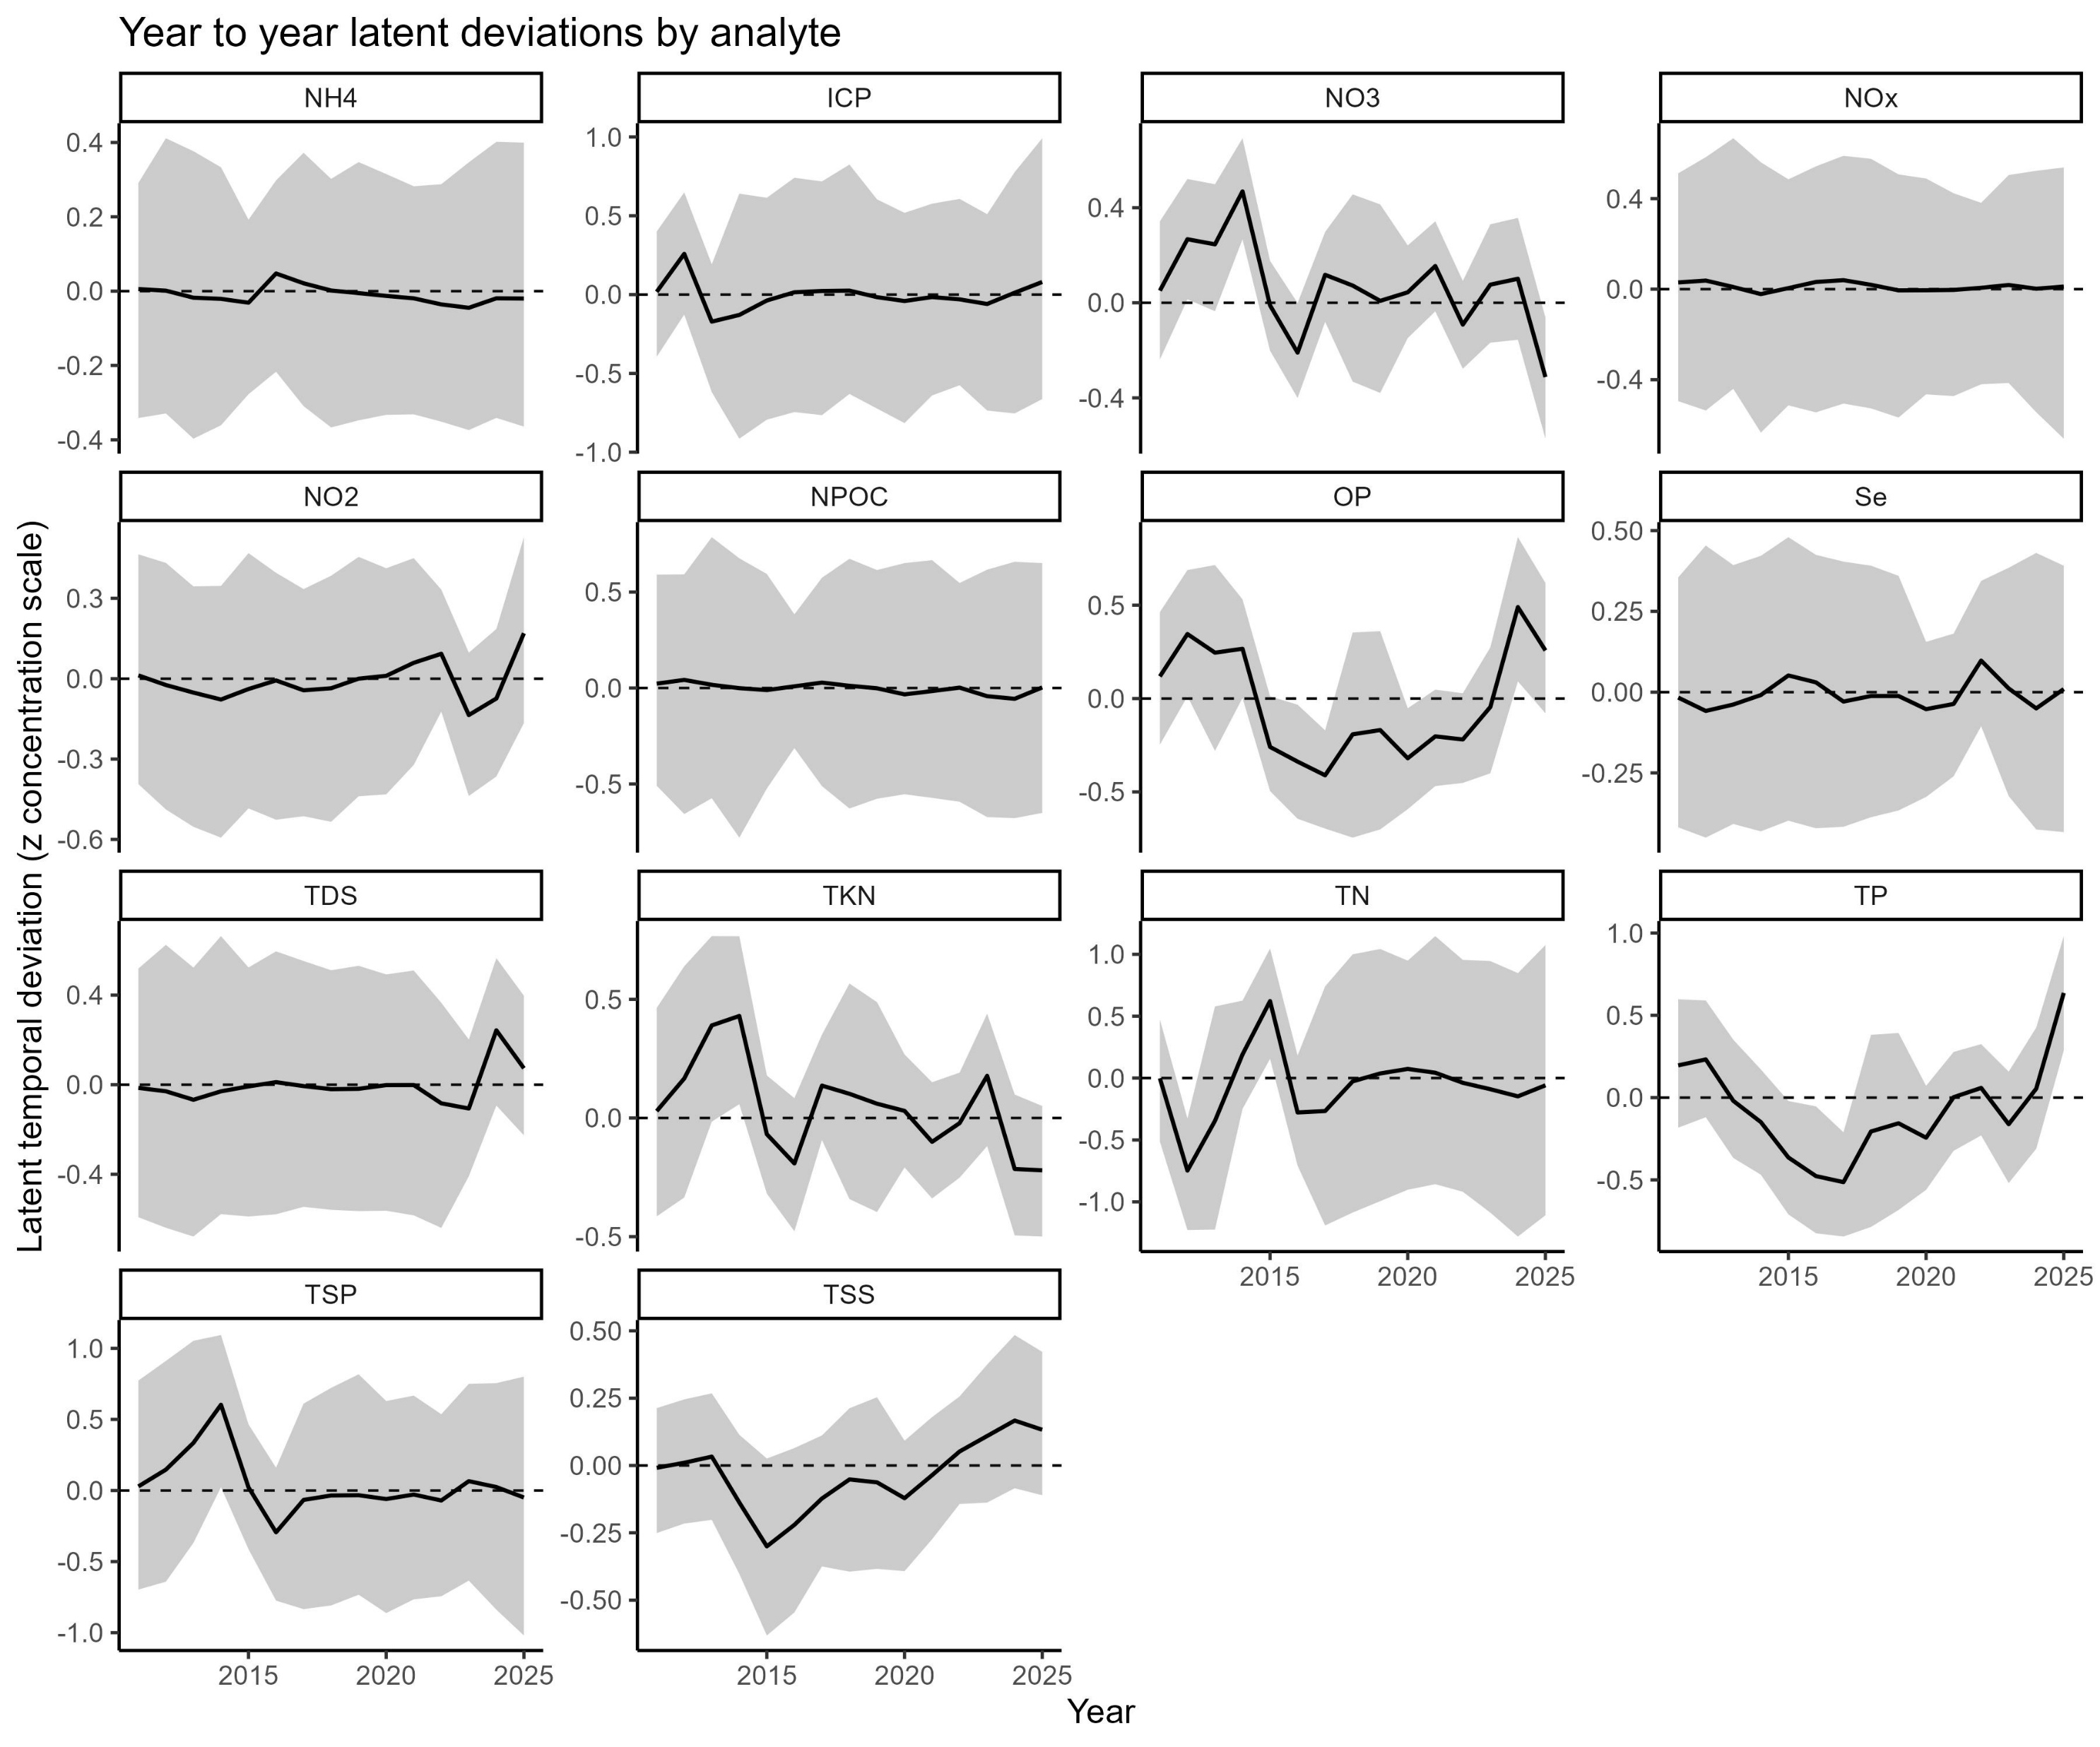
Yesterday (All My Deviations Seemed So Far Away)
Visualize the actual latent AR(1) trajectories for each analyte
These trajectories show how much real-world year-to-year variability remains after accounting for tillage, sampler, block, and irrigation covariates.
NO3, TKN: A sequence of above-average years around mid-study followed by reversion towards baseline, consistent with the moderate ρ.
TP, TSS: More pronounced multi-year deviations, which is biogeochemically plausible because P and sediment export are tightly linked to cumulative soil surface conditions and disturbance history.

Slide 26




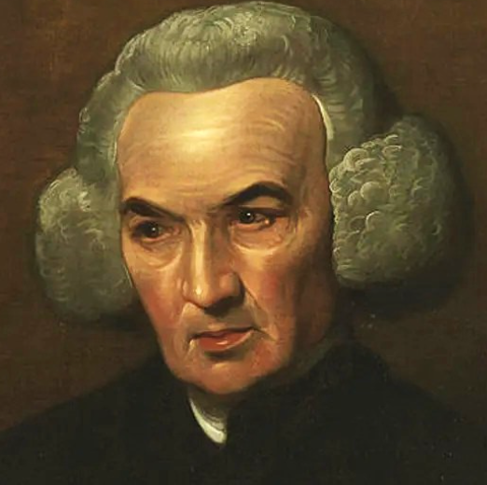
Let It Be… Quantified (Summary)
Certain analytes seem to be very impacted by tillage (STIR)
TP, TSS, OP, TKN primarily
There are temporal effects that persist between years
For TP, TSS, OP, and TKN
Key theme: Solubility!
The Bayes model performed best to worst in the same order as STIR analyte effect
Bayes also let us predict annual loads, even in years with no data, with honest uncertainty

Slide 27

You Can’t Always Get the Effect You Want (Limitations)
The model is not designed to capture analytes dominated by soluble, subsurface, or legacy transport processes; nitrate (NO₃) performance illustrates this limitation clearly.
STIR does not encode fertilizer timing, nitrogen application rate, crop uptake, or subsurface hydrology, all of which strongly influence nitrate dynamics.
Annual load estimates for observed data reflect aggregation uncertainty and monitoring heterogeneity rather than true event-level completeness, particularly in early or sparsely sampled years.
Treatment is not included as a causal predictor, so treatment-level comparisons should be interpreted descriptively, not as direct treatment effects.
The framework assumes event-scale surface runoff as the primary export pathway; analytes governed by longer temporal integration or delayed pathways require additional structure to be modeled mechanistically.

Slide 28

What’s Left?
Investigate STIR → Volume relationship
Decide on which analytes to present, if not all of them
Forecast 2026 and compare?
Try machine learning?
Potential papers currently
STIR impacts on long term WQ and legacy effects
“Completing” a dataset with Bayesian techniques
Will include handling NDs better, right now they’re zero
Validate model using 2026 data?
Not really how Bayes and ML models work but okay
Compare a machine learning model (next slide sneak peak)

Slide 29
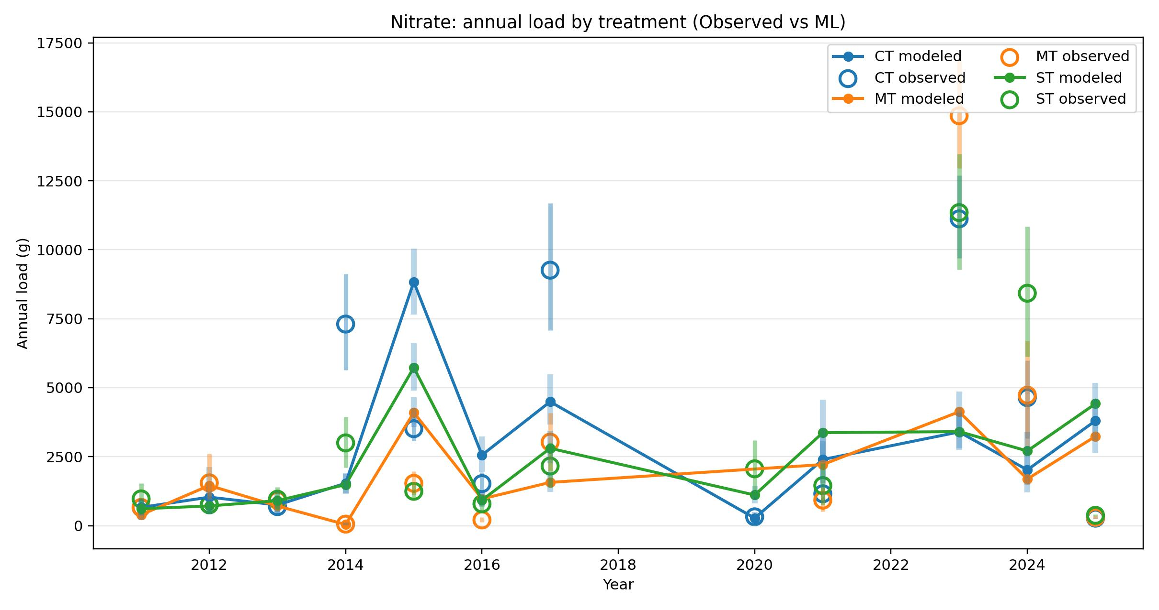
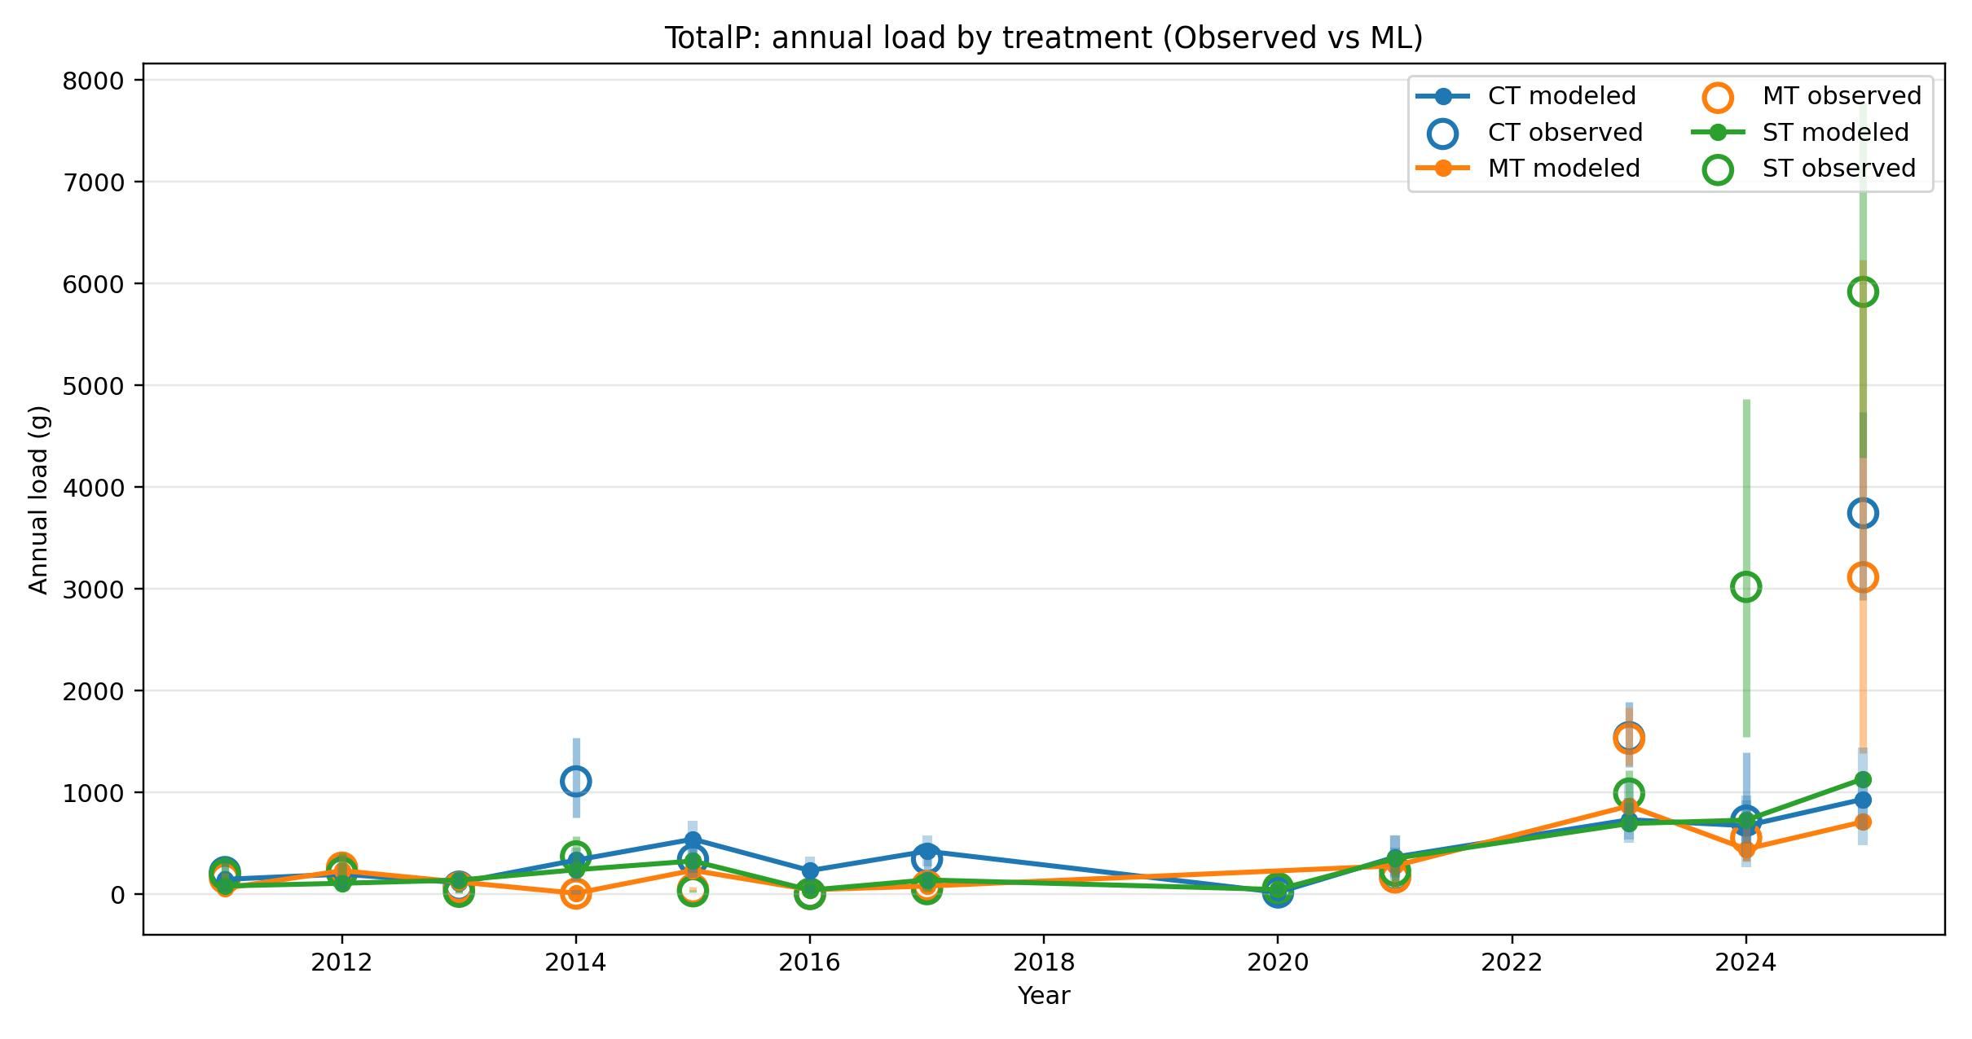

Sneak Peek
Using CatBoost machine learning model to predict concentrations and volumes to derive loads

Slide 30

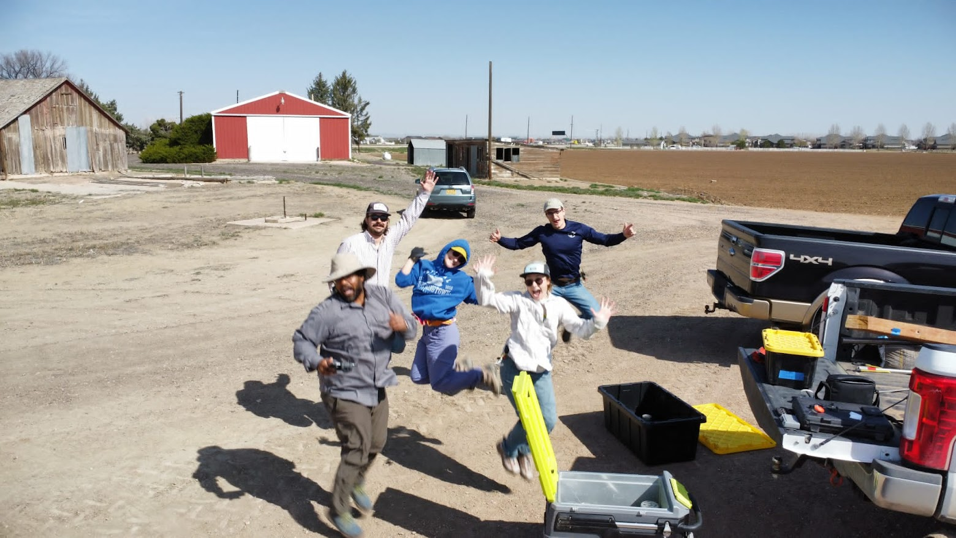

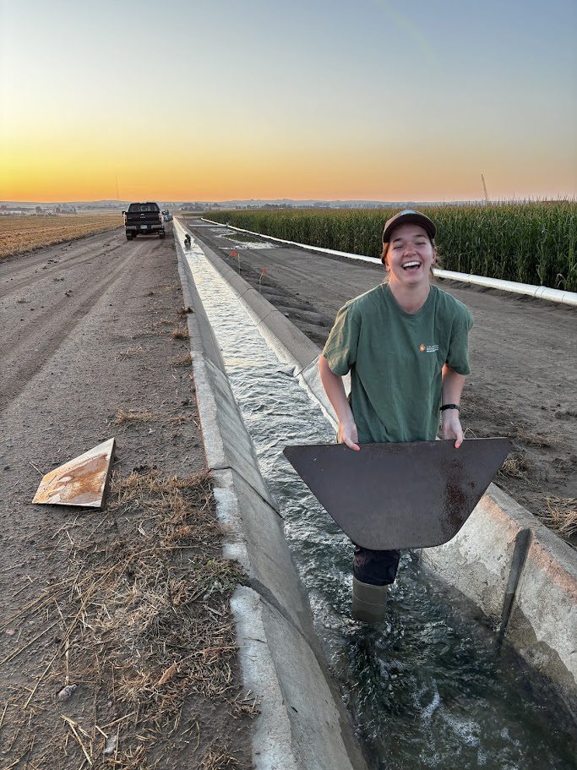
The End
…and in the end, the model you take is equal to the assumptions you make.

